Slide 1
Barnes Air National Guard (ANG) Base
Restoration Advisory Board Meeting #12
July 24, 2025
The meeting will begin soon.
All participants are on mute.

Slide 2
Agenda
6:00 PM Agenda Review and Meeting Logistics
6:05 PM Welcome and Introductions
6:10 PM RAB Business
6:15 PM Community Involvement Plan Update
6:35 PM Non-AFFF Due Diligence
6:45 PM Environmental Restoration Program Status Update
7:15 PM Questions and Comments
7:25 PM Closing Remarks
7:30 PM Adjourn

Slide 3
Meeting Logistics
Amy Brand
Jacobs
RAB Facilitator

Slide 4
Meeting Guidelines
RAB Members
  Ask questions at the end of each topic
  Raise hand to be called on to speak
  Introduce yourself so that everyone (in room and online) knows who is speaking
  Please observe a 2-minute limit to enable other RAB members to participate.
Public Participants
  Hold questions to the end of the meeting
  In the room, raise hand and introduce yourself when called on
  Online, submit questions through the “chat feature”
  Questions will be read and addressed at the end of the meeting

Slide 5
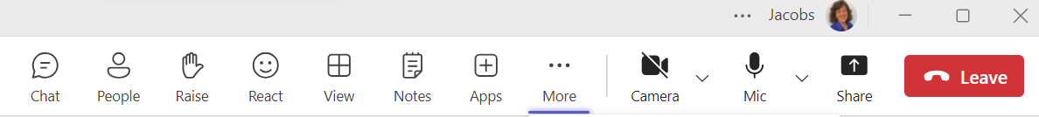
MS Teams - Computer
Camera – Turn OFF to save bandwidth – presentation will be on screen
Participants – On the lower right, click on Participants to open panel
To ask a question:
  RAB Members - Raise hand to be called on to speak, unmute yourself when called on
  Public participants – Use Chat to type your question
Click to raise hand
Click to unmute
yourself
Click to see chat box
Click to see participants

Slide 6
MS Teams Basics – Telephone Participants
Follow along on the slide presentation (emailed or download from 104th Fighter Wing website at https://www.104fw.ang.af.mil/About/Restoration-Advisory-Board/
Use your phone mute button when not speaking
Dial *5 to raise hand to be called on to speak after the presentation
  Use *6 or your phone mute button to unmute and identify yourself when asking a question or making a comment
Any RAB members using a phone? Please identify at beginning of meeting

Slide 7
Welcome and Introductions
Kathy Hillman, Community Co-Chair
Col. David Halasi-kun, Base Co-Chair

Slide 8
Welcome and Introductions
Air National Guard Team
Col. David Halasi-kun (Base Co-Chair) | Robert Lewis, National Guard Bureau
Jennifer Baker, 104th FW Environmental Coordinator | Contractors: BB&E, EA, Dawson, Jacobs
Community RAB Members | BB&E
Kathleen Hillman, Community Co-Chair | Mary Ann Babinski
Chris Clark | Sandi Gil
Kristen Mello | Mary O’Connell
Jane Okscin | Representative Kelly Pease
Dawn Thomas | Senator John Velis
Massachusetts Department of Environmental Protection
Caprice Shaw | Thomas Keefe
Tamara Cardona-Marek, PhD

Slide 9
Welcome and Introductions
U.S. Army Corps of Engineers (USACE) Team
Amanda Martin, Project Manager/ Technical Lead | Grace Greenberg, Risk Assessor
Caitlin Brown, Project Chemist | Mike Narcisi, Wetland Ecologist/Soil Scientist
Dan Folan, PhD, PG, LSP, Geologist/Hydrogeologist | Whitney Sauvé, PE, Environmental Engineer
SRS-Battelle JV Team (USACE Contractor)
Andrew Barton, Battelle, Project Manager |  | James Griffin, SRS, Deputy Project Manager
Max Zelenevich, Field Lead
Contractors
Tom Barzyk, BB&E | Emma Kosub, Dawson
Craig Johnson, EA | Amy Brand, Kathryn Burns, Jacobs
9

Slide 10
RAB Business
Amy Brand, Jacobs
Robert Lewis, National Guard Bureau
Emma Kosub, Dawson

Slide 11
Technical Assistance for Public Participation (TAPP) Grant
  FY24 TAPP Grant (#2)
    Final Document and Presentation provided to RAB 06/30
  FY25 TAPP Grant (#3)
    Approved for funding;
    PWS prepared and with contracting
Notes:
The Program Adjustment Request (PAR) for the TAPP grant was submitted and approved and awaiting funding. Currently under new CR and no timeframe for funding.
Notes from Chris:
The RAB would like a hydrogeologist (preferably academic) to assist the RAB with understanding the how co-contaminant mixing, previous remediation methods impact PFAS chemistry and what the implications are for the treatment of PFAS impacted GW and soils.
Ask for additional comments to be sent to Kathleen for consolidation before sending to me.

Slide 12
RAB Business
Meeting summary – comments and approval
Upcoming meetings
    Fourth Thursday of the month, every 3 months: January, April, July, October
    Adjustments to be made when needed
    Upcoming meetings: October 23, 2025
      January 29, 2026 (note, 5th Thursday)
      April 23, 2026
      July 23, 2026

Slide 13
Barnes ANGB Community Involvement Plan (CIP) Update
Emma Kosub
Project Manager
DAWSON

Slide 14
Barnes ANGB CIP Update
Current Activities:
  CIP Finalized on July 1, 2025
  Will be uploaded to Administrative Record and available to the public
Final CIP Overview:
  Interview Methodology:
    Virtual interviews 12/20/24-2/25/25
    39 local contacts were contacted via email
    RAB members were encouraged to participate and share the survey at 1/30/25 RAB meeting
    Barnes ANGB posted and reposted to the 104th Fighter Wing Facebook page sharing to over 18,000 followers
    13 responses were collected

Slide 15
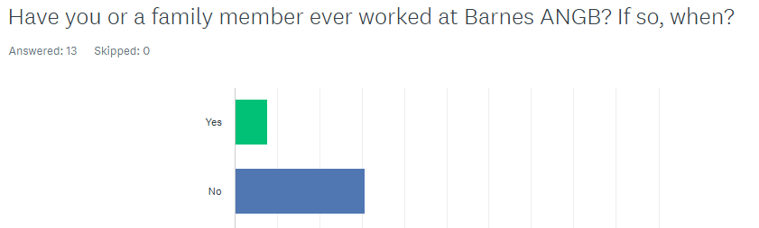
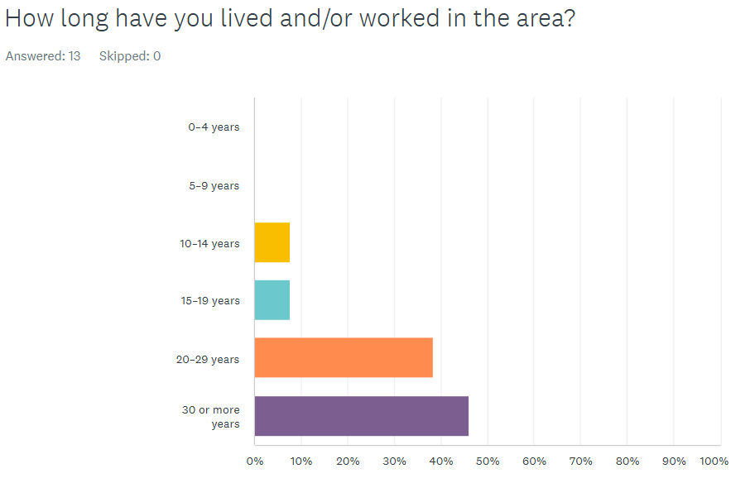
Barnes ANGB CIP Update

Slide 16
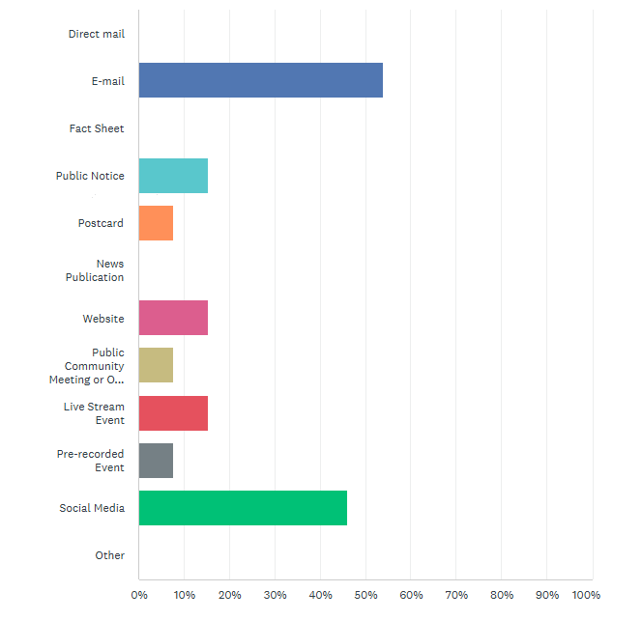
Barnes ANGB CIP Update
Communication Preferences:
  Preferred method for receiving information about environmental projects: Email, social media, public notices, website updates, and a livestream event if one were to be offered.
  Preference indicated sharing ERP updates on a quarterly basis, which aligns with RAB meeting frequency.

Slide 17
Barnes ANGB CIP Update
  Interview Results Continued:
  December 2024 through February 2025 interview respondents indicated that most were not aware of the RAB at Barnes and have not yet attended a meeting.
  When asked how to improve RAB meetings at Barnes ANGB, no comments were received.
  No additional comments were requested from respondents specific to the ERP at this time.

Slide 18
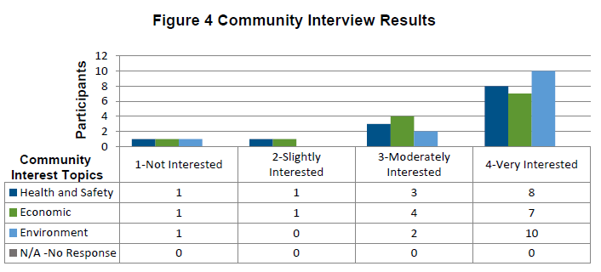
Barnes ANGB CIP Update
  Below are aspects of the ERP that interest respondents:

Slide 19
Barnes ANGB CIP Update
  Final CIP Overview:
  Ongoing and Anticipated Activities:
    Establishing points of contact – PAO/RPM;
    Maintaining AR website and IR;
    Distributing Fact Sheets as needed;
    Maintaining mailing lists of interested groups, individuals, local media and federal, state and local officials;
    Placing public notices in local newspapers to announce public comment periods, public meetings, and other pertinent information; and
    Participating in RAB meetings and/or public meetings.

Slide 20
Barnes ANGB CIP Update
  Upcoming Activities:
  Tentative next CIP update expected 2027
    Please share recommendations for future CIP updates: https://www.surveymonkey.com/r/Barnesupdate
Points of contact for Barnes ANGB:
Public Affairs Officer Email:
Jerry Hewitt jerry.hewitt@us.af.mil
Support Contractor Point of Contact:
Emma Kosub: ekosub@dawsonohana.com

Slide 21

RAB Member Discussion
Please raise your hands and unmute yourself when recognized.
Introduce yourself at the beginning of your question or comment.
Please limit questions to 2 minutes to give other RAB members an opportunity to participate.

Slide 22
Barnes Non-AFFF Due Diligence
Robert Lewis
National Guard Bureau
Craig Johnson
EA

Slide 23
Barnes ANGB non-AFFF PFAS Due Diligence
The Team
U.S. Army Corps of Engineers (USACE), Omaha District
Air National Guard (ANG)
EA Engineering, Science, and Technology, Inc., PBC (under contract to USACE)
Project Objectives
Determine whether and where potential sources of PFAS other than AFFF, were stored, handled, used or released
Identify if a potential PFAS release warrants further investigation or if no further PFAS investigation, study, or cleanup is warranted
Project Tasks
Conduct historical records search of documents such as Environmental Baseline Surveys
Interview personnel familiar with the history and operations of the base
Determine if potential or identified releases of PFAS due to ANG activities require additional investigation
Prepare research reports for each ANG installation

Slide 24
Barnes ANGB non-AFFF PFAS Due Diligence
Research Summary:
Administrative Record Documents digitally searched 658 documents/reports, reviewed other applicable documents, 11 primary documents evaluated
Over 113 shops/locations within Barnes ANGB
Barnes ANGB Environmental Manager was interviewed
5 shops/locations recommended for further evaluation
Schedule
Draft Due Diligence Report February 28, 2025
Draft Final Due Diligence anticipated August 2025
Final Due Diligence anticipated late 2025

Slide 25
RAB Member Discussion
Please raise your hands and unmute yourself when recognized.
Introduce yourself at the beginning of your question or comment.
Please limit questions to 2 minutes to give other RAB members an opportunity to participate.

Slide 26
Environmental Restoration Program Status Update
Robert Lewis
National Guard Bureau
Remedial Project Manager

Slide 27
Environmental Restoration Program
Site 2 Current Status
    Draft Final Permanent Solution Statement (PSS)
    Activity and Use Limitation (AUL) agreed upon with city
    A Lease Amendment signed with city
PFAS Remedial Investigation (RI)
    Final UFP-QAPP forthcoming in July 2025
    Start of field sampling activities pending Access Agreements
Notes:
Speaker: Robert

Slide 28
Barnes Restoration Calendar
2024 |  |  |  | 2025 |  |  |  | 2026 |  |  |  | 2027 |  |  |  | 2028
Q1 | Q2 | Q3 | Q4 | Q1 | Q2 | Q3 | Q4 | Q1 | Q2 | Q3 | Q4 | Q1 | Q2 | Q3 | Q4 | Q1
FY24 |  |  | FY25 |  |  |  | FY26 |  |  |  | FY27 |  |  |  | FY28
Q2 | Q3 | Q4 | Q1 | Q2 | Q3 | Q4 | Q1 | Q2 | Q3 | Q4 | Q1 | Q2 | Q3 | Q4 | Q1 | Q2
FY 24 TAPP Grant
FY 25 TAPP Grant
FY 26 TAPP Grant
UFP-QAPP
RI Field Work
RAB review
RI Report
RAB review
Notes:
Speaker: Robert

Slide 29
Project Fieldwork Scope
Site Access Agreements
Permit compliance
Utility location
Surface soil sampling
Subsurface soil sampling
Surface water and sediment sampling
Vertical aquifer sampling (groundwater)
Groundwater monitoring well installation
Borehole geophysical logging
Piezometer installation
Monitoring well development
Groundwater sampling
Groundwater and surface water elevation monitoring
Location surveying
Habitat assessment
Investigation-derived waste management and disposal
Field record management and reporting
Green = in progress
Yellow = next steps
Notes:
Explain the term “potential” when discussing the first bullet.

Slide 30
Project Fieldwork Schedule
Activity | Schedule
Access agreements & permits | Ongoing
Utility location | August 2025
Surface soil sampling, round 1 | August 2025
Background surface soil sampling | August-September 2025
VAS | August-September 2025
Surface soil sampling, round 2 | October-November 2025
Subsurface soil sampling, round 1 | October-November 2025
Subsurface soil sampling, round 2 | January-February 2026
Monitoring well installation | August 2025-January 2026
Notes:
Explain the term “potential” when discussing the first bullet.

Slide 31
Project Fieldwork Schedule
Activity | Schedule
Groundwater sampling, round 1 | May 2026
Groundwater sampling, round 2 | October-November 2026
Piezometer installation | October 2025
Surface water/ sediment sampling, round 1 | October 2025
Surface water/ sediment sampling, round 1 | May 2026
Habitat Assessment | May 2026
Notes:
Explain the term “potential” when discussing the first bullet.

Slide 32
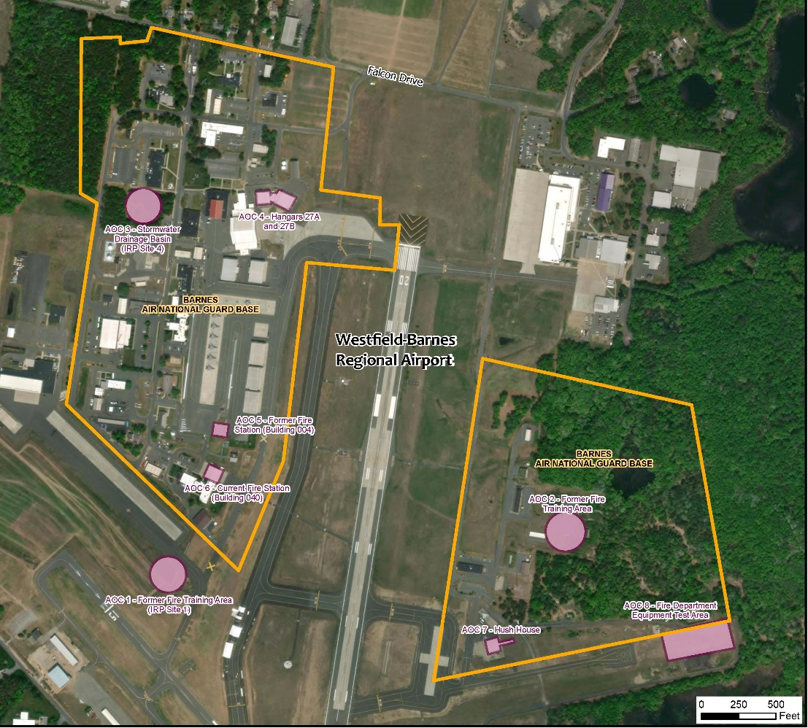
PFAS RI
Site Layout
AOC 3
AOC 4
AOC 1 – Former Fire Training Area
AOC 2 – Former Fire Training Area
AOC 3 – Stormwater Drainage Basin
AOC 4 – Hangars 27A and 27B
AOC 5 – Former Fire Station
AOC 6 – Current Fire Station
AOC 7 – Hush House
AOC 8 – Fire Department Equipment Test Area
AOC 5
AOC 6
AOC 2
AOC 1
AOC 7
AOC 8
Notes:
Explain the term “potential” when discussing the first bullet.

Slide 33
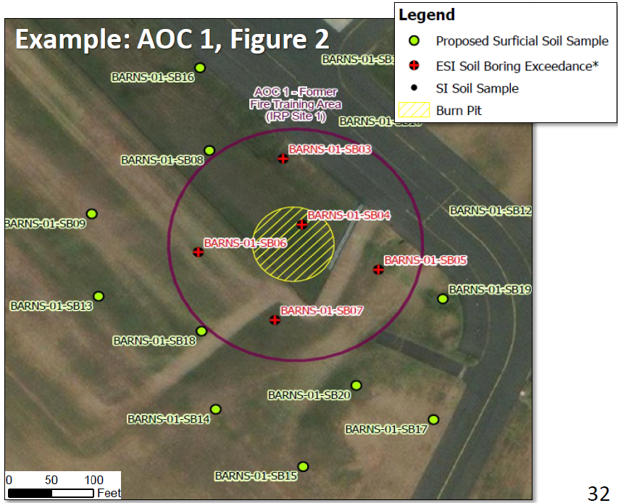
Soil Sampling
Area | No. of Samples | Questions to be Answered
AOC 1 | 13 | Where did releases of materials containing PFAS occur? Where and at what concentrations are PFAS present in soils now?
AOC 2 | 10
AOC 3 | 8
AOC 4 | 8
AOC 5 | 10
AOC 6 | 10
AOC 7 | 11
AOC 8 | 10
Background | 10 | What are background levels of PFAS in soil?
Note: Subsurface soil borings will be drilled based on surface soil results

Slide 34
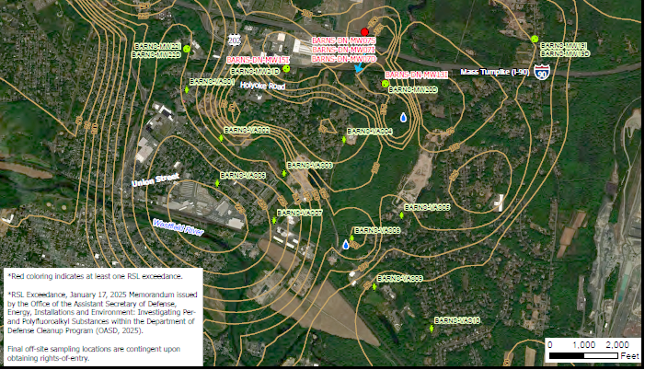
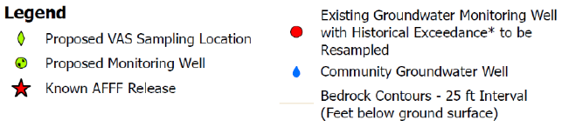
VAS (Groundwater)
No. of Loc. | Depths | Questions to be Answered
10 | Top of groundwater table plus 3 depths based on lithology | What is the spatial and vertical distribution of PFAS in groundwater? Where should permanent wells be located and what depth of groundwater they should screen?

Slide 35
RAB Member Discussion
Please raise your hands and unmute yourself when recognized.
Introduce yourself at the beginning of your question or comment.
Please limit questions to 2 minutes to give other RAB members an opportunity to participate.

Slide 36
Public Questions and Comments
In person: Raise hand to be recognized
Online: Submit questions using chat

Slide 37
Contact Information
104th Fighter Wing, Barnes Air National Guard Base
Base Co-Chair Commander Col. David Halasi-kun | Environmental Manager Jennifer Baker | 104th FW Environmental Manager Mr. John Richardson | Public Affairs Manager Jay Hewitt (413) 568-9151 x 698-1202 Jerry.hewitt@us.af.mil
Community Co-Chair
Kathleen Hillman khillman179@gmail.com RAB members, please submit questions and comments through your Community Co-Chair
National Guard Bureau |  | Massachusetts Department of Environmental Protection
Program Manager Robert Lewis (240) 612-8473 robert.lewis.100.ctr@us.af.mil |  | Caprice Shaw (413) 540-6253 Caprice.shaw@mass.gov

Slide 38
Websites for More Information
Environmental Restoration Program at 104th Fighter Wing
  General and Links to PFOS/PFOA Information: https://www.104fw.ang.af.mil/About/Environmental/
  Restoration Advisory Board: https://www.104fw.ang.af.mil/About/Restoration-Advisory-Board/
Relative Risk Site Evaluation (RRSE)
  Barnes RRSE: https://www.104fw.ang.af.mil/Portals/5/Barnes_RRSE%20Fact%20Sheet%20and%20Scoring%20Summaries_211215.pdf
  RRSE Primer: https://www.denix.osd.mil/references/dod/policy-guidance/relative-risk-site-evaluation-primer/RRSE_Primer_Summer1997.pdf
  104th Fighter Wing Environmental Administrative Record
  https://ar.afcec-cloud.af.mil/Search.aspx (Select ANG radio button, select Barnes, and click on search)
  MassDEP PFAS Information
  https://www.mass.gov/info-details/per-and-polyfluoroalkyl-substances-pfas
  Westfield Water Department PFAS Information
  https://www.cityofwestfield.org/672/PFCs-Information-Updates
  RAB Rule Handbook and Information on Technical Assistance for Public Participation
  https://www.denix.osd.mil/rab/home/
  Air Force Response to PFOS and PFOA
  https://www.afcec.af.mil/WhatWeDo/Environment/Perfluorinated-Compounds/

Slide 39
Closing Remarks
Kathleen Hillman
Col. David Halasi-kun

Slide 40
Adjourn

